Slide 1
Machine Learning - 1
Unit 3

Slide 2
Support
Vector
Machine

Slide 3

Support Vector Machine ( SVM )
In simple terms
Support Vector Machine is a supervised machine learning algorithm that can be used both for classification and regression.
SVM is used for binary classification and multi-class classification.
Objective
The goal of the SVM algorithm is to create the best line that can divide the dataset into classes so that we can easily put the new data point in the correct category in the future.

Slide 4
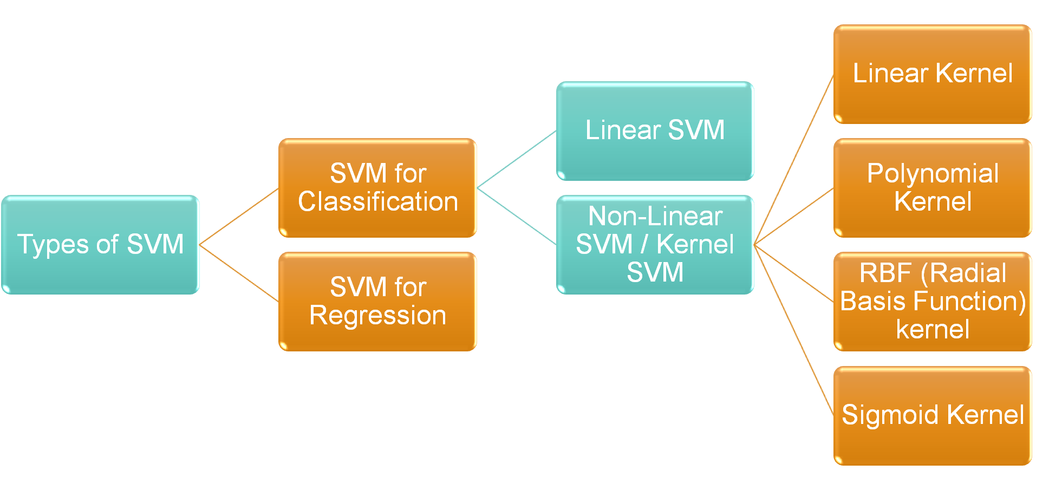
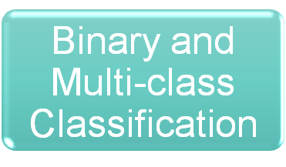
Types of SVM

Slide 5


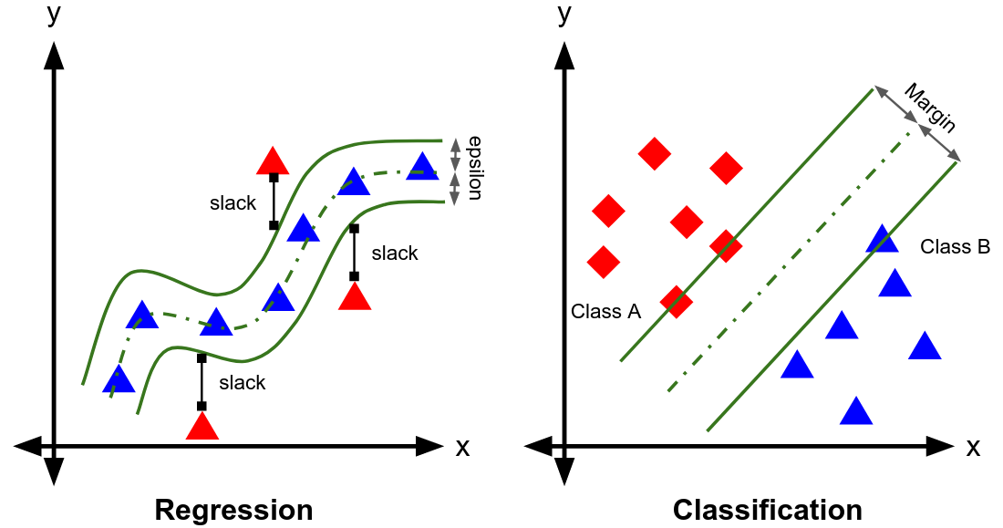
Types of SVM
1. SVM for classification
2. SVM for Regression
SVM-Classification is used to predict discrete values or categories
SVM-Regression is used to predict continuous values

Slide 6
Types of SVM Classification - Binary
1. Linear SVM
Linear SVM is used for linearly separable data, which means if a dataset can be classified into two classes by using a single straight line and the classifier used is Linear SVM classifier.
2. Non-Linear SVM
Non-Linear SVM is used for non-linearly separated data, which means if a dataset cannot be classified by using a straight line and the classifier used is Non-linear SVM classifier.

Slide 7
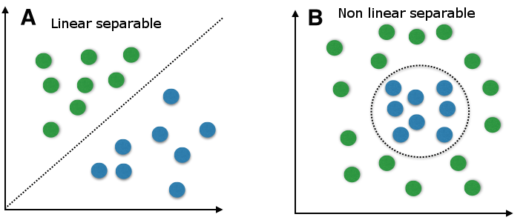
SVM for classification
Types of SVM
Linear SVM
Non-Linear SVM

Slide 8
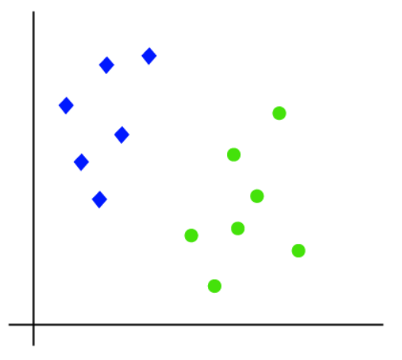
1. Working of Linear SVM with an Example
Consider we have a dataset that has two tags (green and blue), and the dataset has two features x1 and x2.
Since, it is 2-d space just by using a straight line we can easily separate these two classes.

Slide 9
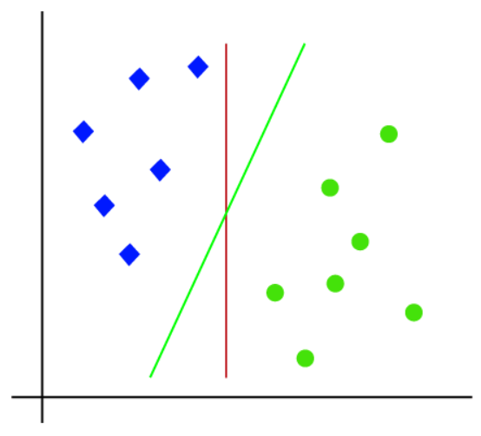
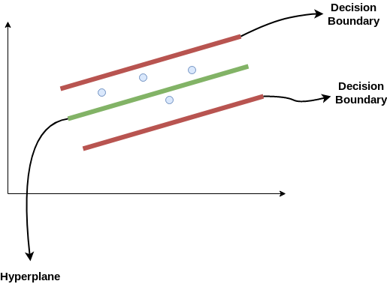


1. Working of Linear SVM with an Example
Hence, the SVM algorithm helps to find the best line or decision boundary; the best fit line is called as a hyperplane.
But there can be multiple lines that can separate these classes.

Slide 10

1. Working of Linear SVM with an Example
SVM algorithm finds the closest point of the lines from both the classes. These points are called support vectors.
Formal definition from:
Kevin P. Murphy, ― Machine Learning: A Probabilistic Perspective‖, MIT Press, 2012, Pg:496
Subset of the training data, known as support vectors.

Slide 11
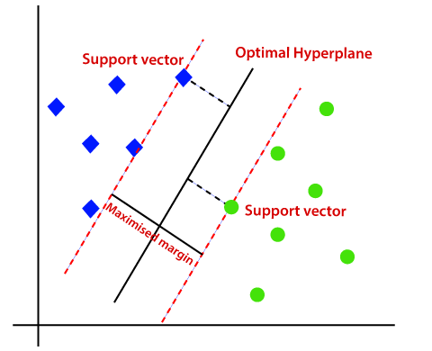
1. Working of Linear SVM with an Example
The distance between the vectors and the hyperplane is called as margin. And the goal of SVM is to maximize this margin.
The hyperplane with maximum margin is called the optimal hyperplane.

Slide 12
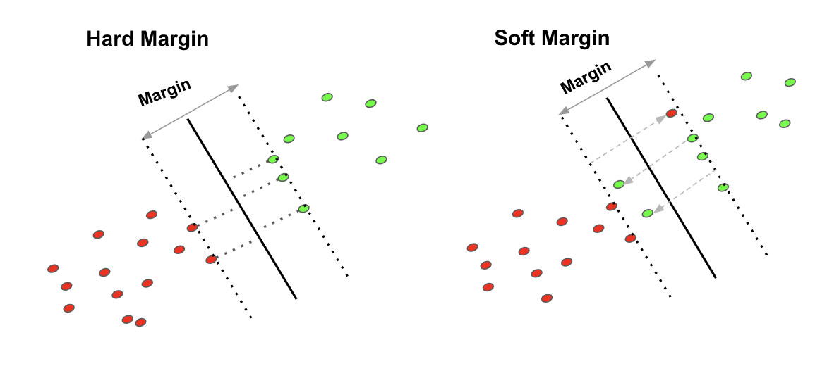
1. Working of Linear SVM with an Example
Hard Margin requires that all data points are classified correctly.
Soft Margin allows mis-classification of difficult/noisy data points.

Slide 13
Support Vector Machine + Kernels

Slide 14
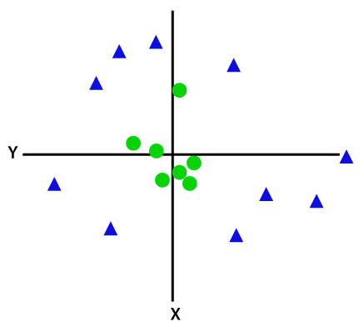
2. Kernel / Non-Linear SVM
If data is linearly arranged, then we can separate it by using a straight line, but for non-linear data, we cannot draw a single straight line.
Here is where SVM uses a special function called Kernel function.

Slide 15

2. Kernel / Non-Linear SVM
Kernel function
A Kernel Function is a method used to take data as input and transform into the required form of processing data.
Kernel function places a low dimensional plane to a higher dimensional space where it can be segmented using a plane.
Kernel transforms linearly inseparable data to separable data by adding more dimensions to it.

Slide 16
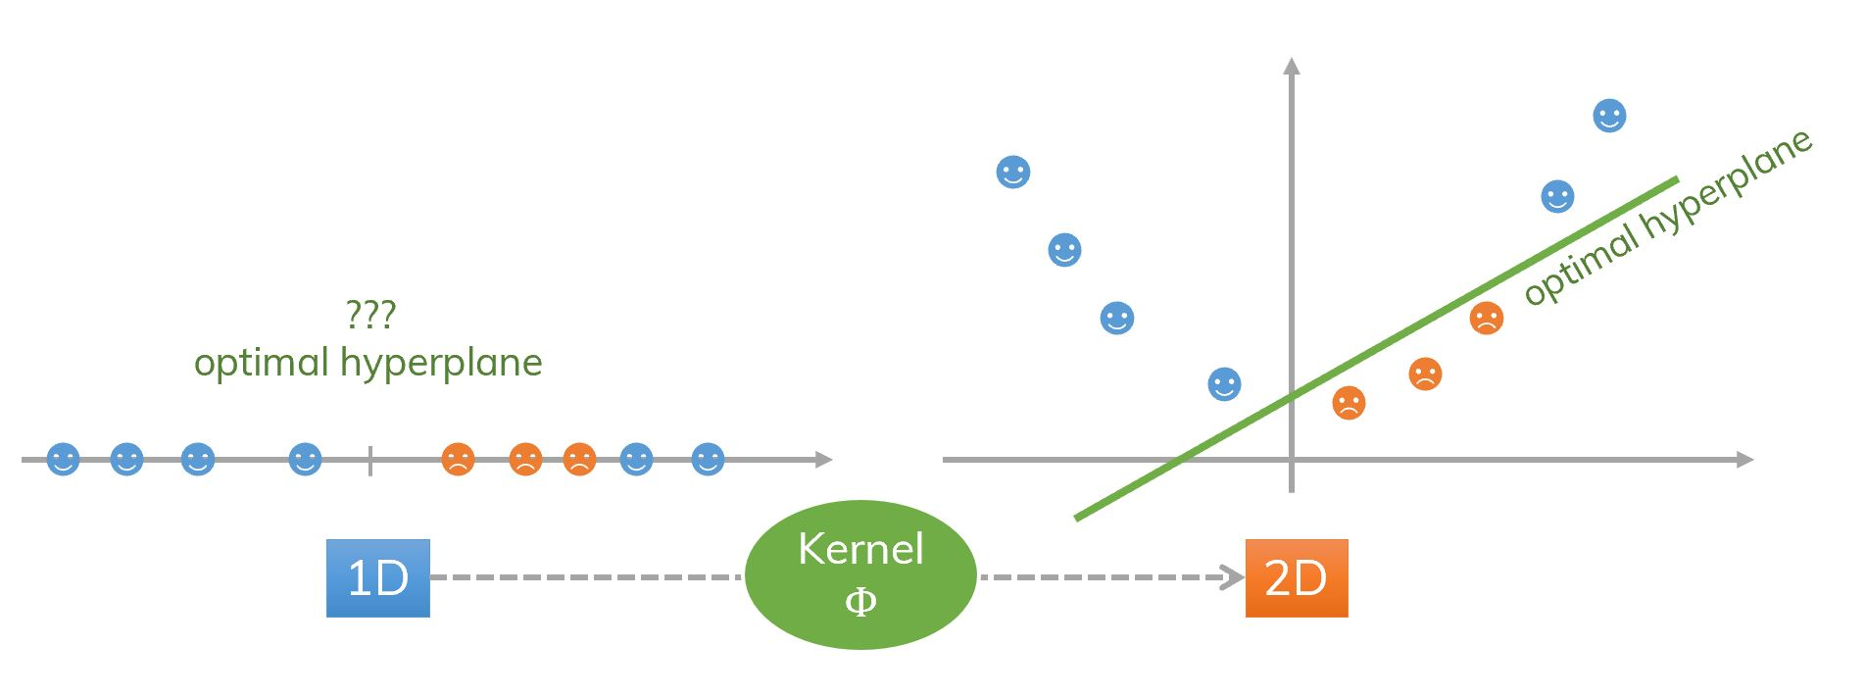

2. Kernel / Non-Linear SVM
Mapping Low Dimensional data to a higher dimension using kernel function
Therefore, a 1-D non-linearly separable data is made linearly separable by transforming it into a 2-D space through a kernel function.

Slide 17
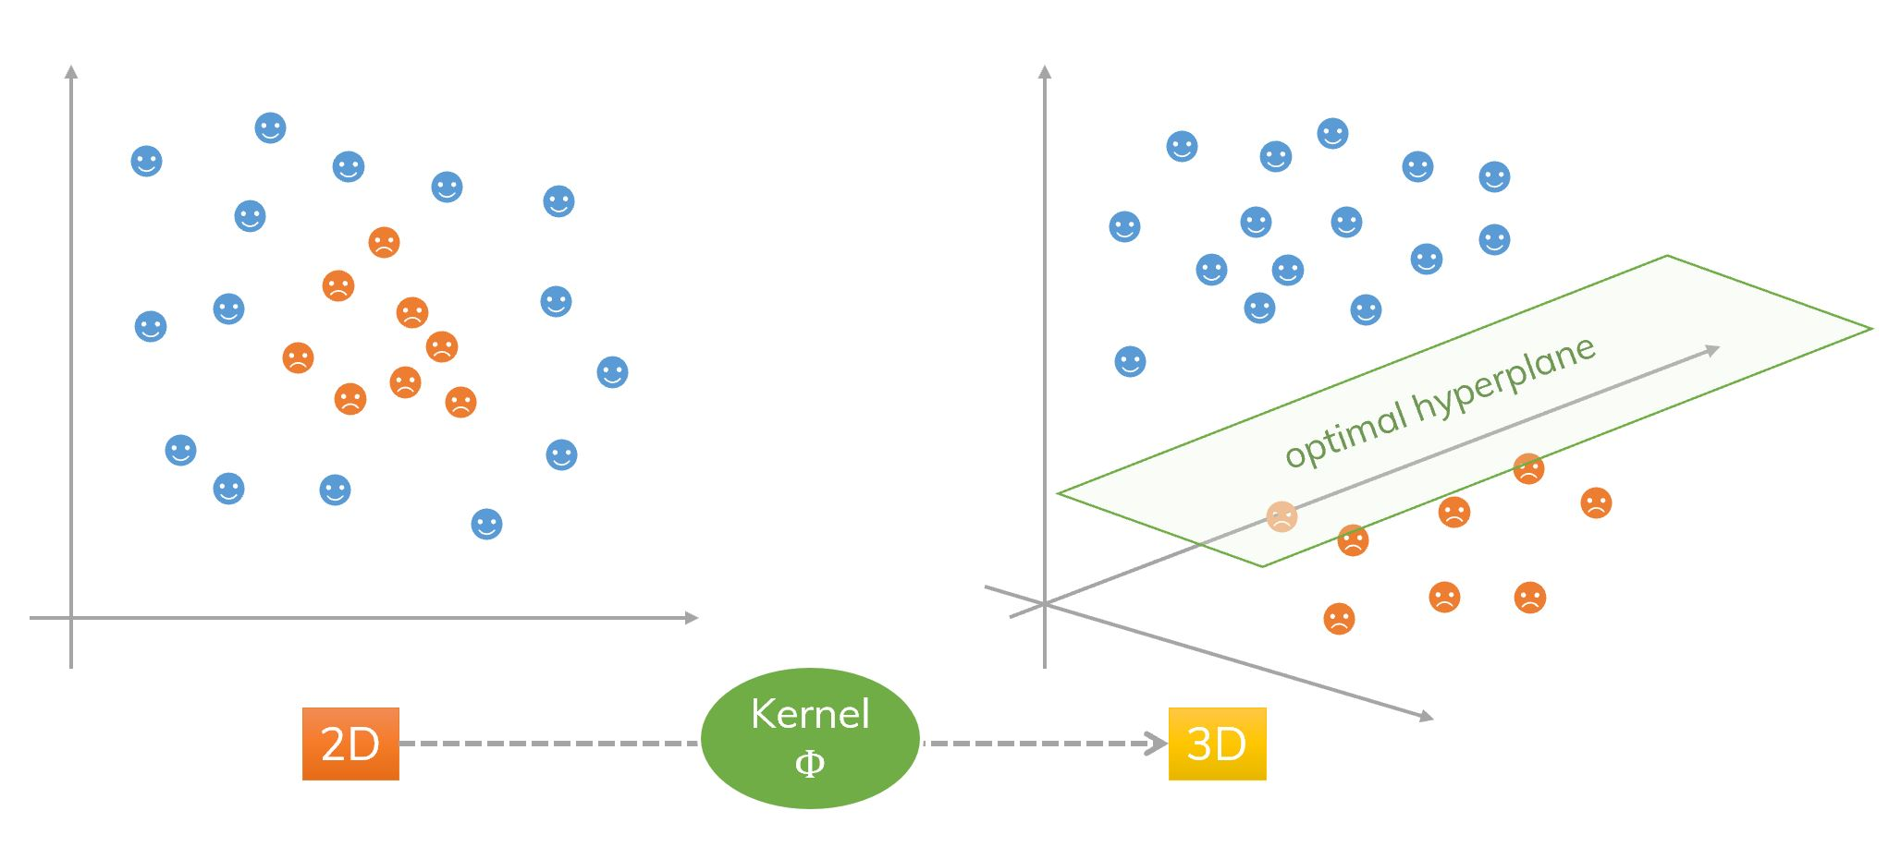
2. Kernel / Non-Linear SVM
Mapping Low Dimensional data to a higher dimension using kernel function
Therefore, a 2-D non-linearly separable data is made linearly separable by transforming it into a 3-D space through a kernel function.

Slide 18
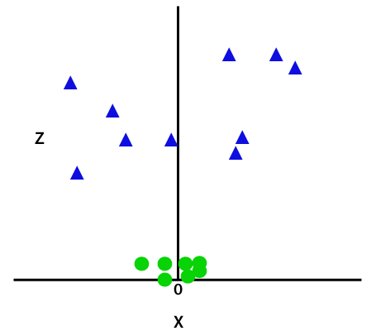
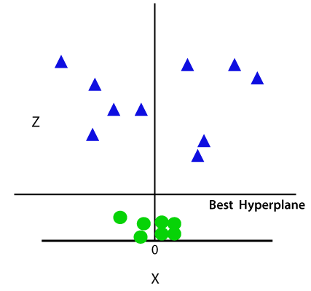

2. Working of Non-Linear SVM with an Example
To separate these data points, we need to add one more dimension ‘z’.
z = x² +y²
SVM will divide the datasets into classes in this 3-d space.

Slide 19
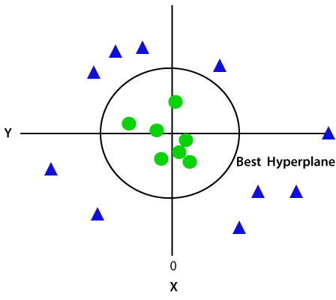

2. Working of Non-Linear SVM with an Example
Again, convert it in 2d space with z=1.
Hence, Non-Linear SVM divides the dataset into classes with the help of kernel function.

Slide 20
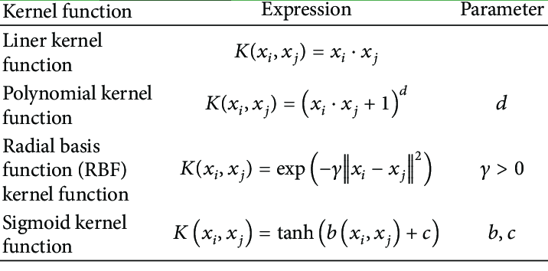
Kernel functions and their Mathematical formulas
Kernel functions transform the low dimensional data to high dimensional data using these mathematical formulas.

Slide 21
SVM for Regression
Support Vector Regression is used to solve regression problems which handles continuous values..
Support Vector Regression gives priority to hard margin. A hard margin classifies the data points correctly.
This also allows soft margin as well. Which means, a few data points can be outside the margin.
Sensitive to outliers

Slide 22

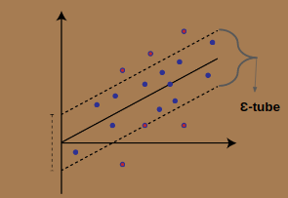
SVM for Regression
SVM generalization to SVR is accomplished by introducing an e-insensitive region around the function, called the e-tube / Epsilon tube.
The tube that best approximates the continuous-valued function, while balancing model complexity and prediction error is chosen.

Slide 23
SVM for Regression
SVR outputs a number rather than a class.
The best regression with higher accuracy in a reasonable amount of time is found by tuning the parameters.
The tuning parameters are:
Regularization
Gamma
Epsilon

Slide 24
Tuning parameters - SVR
1. Regularization: (C parameter)
This tells the SVM optimization on how much you want to avoid misclassifying on each training sample.
C parameter balances the trade-off between the model complexity and empirical error.
To simplify, when C is large, the SVM tends to be over-fitting while when C is small, the SVM tends to be under-fitting.

Slide 25
Tuning parameters - SVR
2. Gamma: (γ parameter)
The gamma parameter defines how far the influence of a single training example reaches (low values mean far and a high value means close).
When γ is large, the SVM tends to be overfitting.
When γ is small, the SVM tends to be underfitting.

Slide 26
Tuning parameters - SVR
3. Epsilon:
Epsilon intensive loss function defines the loss function that ignores errors and affects the smoothness of the SVM’s response.
Epsilon has a function to give a tolerable error of the regression model.
If we need a high tolerable error, we can increase the epsilon intensive band.
If we need a low tolerable error, we can decrease the epsilon intensive band.

Slide 27
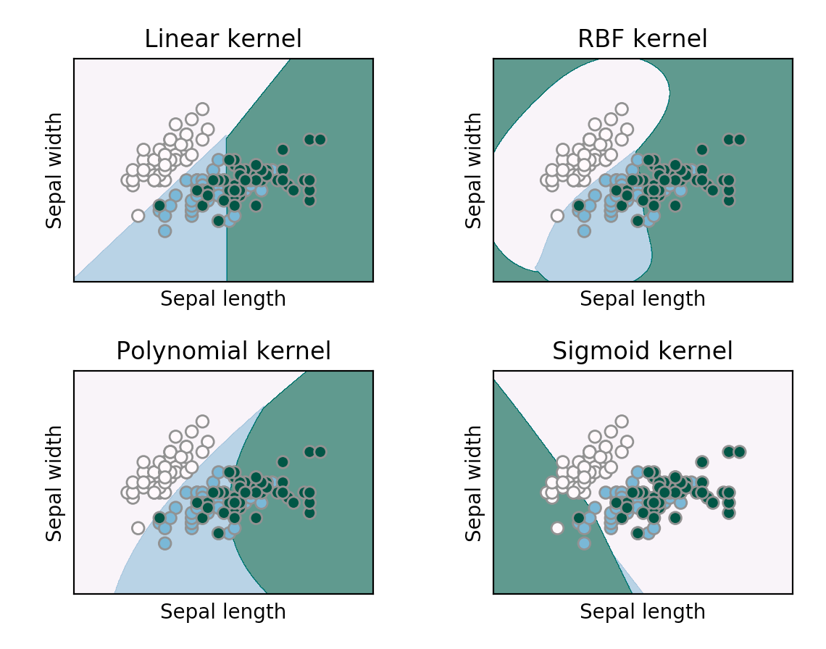
Comparing SVM kernels

Slide 28
SVM
Multiclass classification

Slide 29
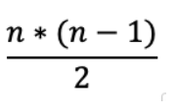
SVM Multi-class classification
SVM can also be applied for multi-class classification.
The multiclass problem is broken down to multiple binary classification cases, which is also called one-vs-one.
It basically divides the data points in class x and rest. Consecutively a certain class is distinguished from all other classes.
The number of classifiers necessary for one-vs-one multiclass classification can be retrieved with the following formula (with n being the number of classes):

Slide 30
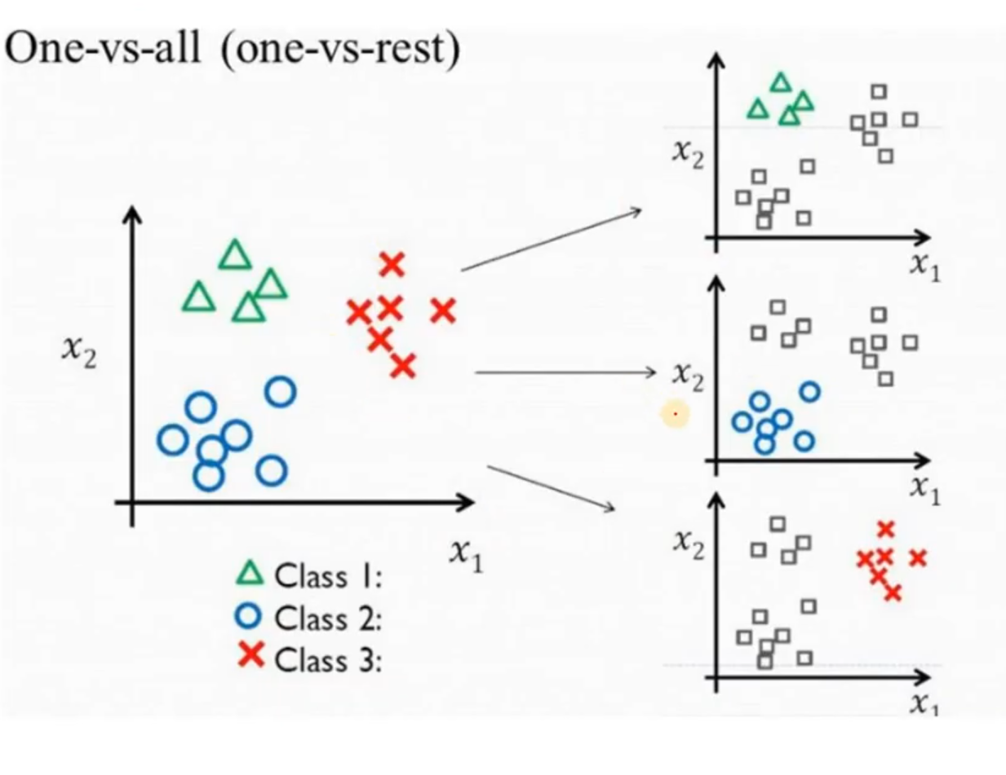

SVM Multi-class classification
In the one-vs-one approach, each classifier separates points of two different classes and comprising all one-vs-one classifiers leads to a multiclass classifier.

Slide 31
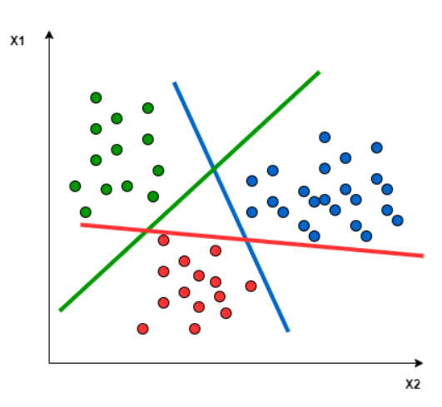
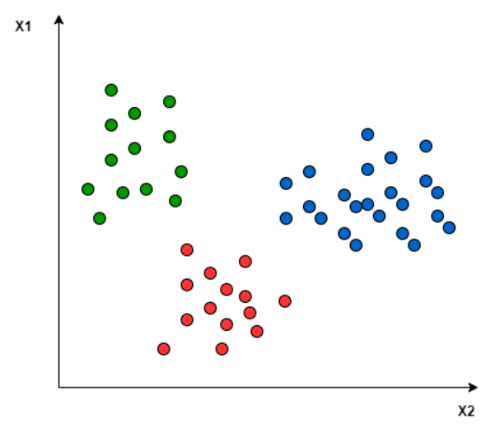
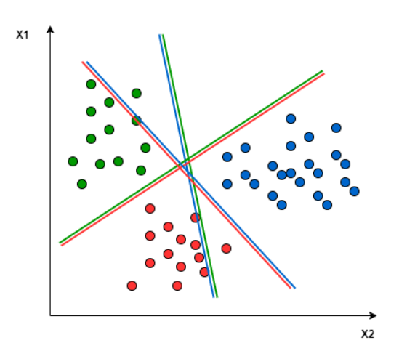
SVM Multi-class classification
Three class classification problem
Hyperplane to separate every two classes
Optimal Hyperplane that separates every two classes

Slide 32
Advantages of SVM
Effective in high dimensional spaces.
Still effective in cases where number of dimensions is greater than the number of samples.
Uses a subset of training points in the decision function (called support vectors), so it is also memory efficient.
Versatile: different Kernel functions can be specified for the decision function. Common kernels are provided, but it is also possible to specify custom kernels.

Slide 33
Dis-advantages of SVM
If the number of features is much greater than the number of samples, avoid over-fitting in choosing Kernel functions and regularization term is crucial.
SVMs do not directly provide probability estimates, these are calculated using an expensive five-fold cross-validation.

Slide 34
Summary

Slide 35
Thank You

